Slide 1


Operationalization of Food Nutrition Health and WASH (FNHW) under DAY-NRLM
Orientation of District and Block level
National Mission Management Unit, Deendayal Antyodaya Yojana – National Rural Livelihoods Mission (DAY-NRLM)
Ministry of Rural Development, Government of India

Slide 2
Content
Rationale for integrating FNHW and context of Dashasutra strategy
Overview of National FNHW Strategy
Overview of State FNHW Operational Strategy
Implementation structure for operationalization of FNHW
Roles and responsibilities of District and Block Managers
Steps to roll FNHW interventions at district and block
Budget
Available resource material and how to use?

Slide 3
Rationale for integrating FNHW
DAY- NRLM is a flagship poverty alleviation programme of MoRD and mobilizes rural women in SHGs and its federations and provides opportunity to generate livelihoods
Livelihoods and good health are inter- dependent - a healthy person is able to engage in livelihood activities to her/his full potential
Given its scope, vast social capital and its effectiveness, the DAY- NRLM is an effective platform to tackle the underlying causes of poor health and nutrition.

Slide 4
Multi-dimensional Poverty and Malnutrition
Income Poverty
Poor Purchasing Power / Education / Knowledge / Empowerment / Mobility
Poor Hygiene
Poor Sanitation
Lack of Water
Food and Nutrition Insecurity
Frequent Infections / Illness
High Exposure to Physical Labour
Poor Social Status of Women
Poor Knowledge on Maternal & Child care/ Feeding
Large families, Early Marriage
Poor Maternal & Child care
Increase in demand for Nutrients
Increase in requirement of diversified diet
Poor Nutrient Intake
Loss of Nutrients
Low Decision Making Power
Nutrient demand not met
MALNUTRITION
Direct Loss of productivity Poor physical Output
Indirect loss of Productivity Poor attendance at work/ school
Loss of Income/ resources High Investment in health care

Slide 5





Why integrate FNHW?
Proper Nutrition

Health Services

Increased savings
Overall wellbeing and improved quality of life
Appropriate Sanitation and Hygiene
Less Expenditure on Health/Diseases

Slide 6
Advisories on FNHW integration
In 2016- an advisory on Dashasutra mandating FNHW integration (link 1)
FNHW integration
reduces expenditure on medical care
increases economic productivity
improves the quality of life of rural women and their families
In 2017- a Master Circular on FNHW to outline FNHW interventions (link 2)
In 2018- Joint advisory by MoWCD, MoRD and MoHFW to guide modalities of convergence (link 3)
In 2020- An advisory to strengthen Social Behaviour Change Communication approaches for improved FNHW outcomes (link 4)
In 2020- An advisory to guide development of State FNHW Operational Strategy and functions of SRLM staff and cadres
1. https://drive.google.com/file/d/1oOlOSsY97aGnOtxStXjwHUYy7BVyBK98/view?usp=sharing
2. https://aajeevika.gov.in/sites/default/files/Master%20Circular%20for%20Food%2C%20Nutrition%2C%20Health%20and%20Wash%20Interventions.pdf
3. https://aajeevika.gov.in/sites/default/files/Joint%20Advisory%20on%20Nutrition.pdf
4. https://drive.google.com/file/d/1-pNEZtYKyPcaSwvGTsJZ1rLtZShzYHnT/view?usp=sharing

Slide 7
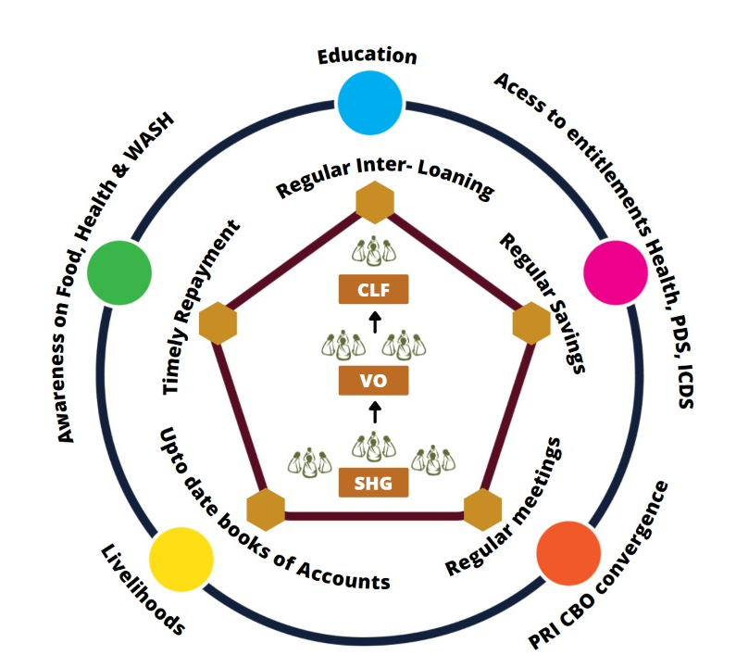
Dashasutra Strategy- 2016
Integrating livelihoods and social development for holistic growth of communities
Micro-credit and financing
Including social development - Food, Nutrition, Health and WASH, Gender etc.

Slide 8
FNHW: Under Dashasutra Strategy SHGs are required to
Include social issues (including issues pertaining to Food, Nutrition, Health & WASH) that affect members as part of meeting agenda
Meetings should act as platform for discussion on health issues along with line agencies & PRI, invite ASHA & Anganwadi worker to their weekly meeting & benefit from their advice
Discuss malnutrition issues of women & children, pregnant & lactating mothers & facilitate their access to supplementary nutrition, healthcare & other entitlements
Every meeting should start with all members with washing hands
Discuss promotion of personal hygiene, food hygiene & prevention of open defecation
Each member should ensure that an individual sanitary toilet is built & used by all members of the household

Slide 9
FNHW: Opportunity for Integration
Existing platform & extensive reach
Multiple points of contact
Working on agriculture, dairy, poultry & small ruminants
Working on financial products, social marketing & enterprise
Skilled manpower – Staff & Cadre
Ability to influence social norms, peer learning & influence
Focus on marginalized groups

Slide 10
Overview of the National FNHW Strategy

Slide 11



FNHW Focus Areas
FOOD
Nutri-Garden
Access to PDS
Access to THR
Mid Day Meal
FNHW Enterprises
HEALTH & NUTRITION
Antenatal Care | Anemia reduction
New Born Care | Family Planning
1000 Days | Health & Nutrition for the Elderly and PWD
Infant and Young Child Feeding | Nutrition and Health during NCDs
Maternal Nutrition | Menstrual Hygiene
Family Diet diversity
WASH
Use of sanitary toilet
Handwashing practices
Management of household waste

Slide 12
Overview of the Strategic Pillars
System strengthening (improved ability of the system to integrate FNHW)
Convergence (convergence with line departments and SRLM verticals for improved services)
SBCC (promoted behavior change among SHGs)
FNHW Enterprise (established FNHW enterprises managed by SHGs)
Identify FNHW nodal person Form core committee Develop strategy, guidelines, SOPs and other documents Develop resource pool Design special packages of services and resource materials Decide training cascade and undertake capacity building for SRLM nodals at state, district, block, CLF, VO and SHG levels. Establish schedule of reporting, review and monitoring
Modify job description of concerned staff and cadre Decide on lead, participants, schedule and frequency of convergence meetings Conduct and regularize convergence meetings - with other verticals - with line departments Support programs of other ministries
Develop/adapt and roll out SBCC strategy and package of practices/tools (modules) Organize/participate in VO level events/campaigns to bring out behaviour change in community Undertake home visit, peer counselling and mobilize target groups to attend VHSNDs and community events like Annaprashan Diwas and Godbharai. Develop/adapt tools and materials for SBCC and other activities for reaching out to the target group
Identify FNHW needs and suggest enterprises to cater to the needs of the community Promote enterprises relevant to target group - goatary/poultry/ FNHW enterprises etc. Promote utilization of FNHW enterprise products Share learning from successful enterprises

Slide 13
Overview of the State FNHW Operational Strategy
Next few slides (14-17) are specific to State FNHW Operational Strategy. State Managers are expected to fill in the desired information.

Slide 14
State Profile and Identification of FNHW Geographies
Write introduction to the State SRLM in one line
State map depicting FNHW geographies (Districts)
State name
Population*
Literacy Rate*
Sex Ratio*
 | Total | NRETP | NRLM
No. of Districts
No. of Blocks
Source: *Census, 2011

Slide 15
State Profile- Key FNHW indicators
Key highlights
Key Health Indicators of State & Focus Districts
Depict through graph
Key Nutrition Indicators of State & Focus Districts
Depict through graph
Source: NFHS 5, 2019-20

Slide 16
FNHW Synthesis from State FNHW Operational Strategy
3. Goal
4. Objectives
5. Clientele/Target Group
Focus areas
Describe in brief
Process of developing State FNHW Operational Strategy, selection of interventions, revision based on progress of implementation

Slide 17
FNHW Synthesis from State FNHW Operational Strategy
6. Geographic areas of Operation (as per sanctioned project)
YEAR 1 | District | Blocks | No. of GPs | No of CLFs | No of VOs | No of SHGs
YEAR 2
YEAR 3
6. Key interventions/activities to be implemented
Budget availability
FNHW - ………………

Slide 18
Delivering FNHW interventions
Requisites to rolling out FNHW interventions
Appropriate orders/advisories are released by State
State FNHW Operational Strategy is in place with budgetary provisions in State Annual Action Plan (AAP)
Nodals are appointed at district/block and CBO level
District and Block Managers are oriented on FNHW components
FNHW related functions are included in the KPIs of staff and cadre across levels
Relevant resource materials developed/adapted– Flip Books and SOPs
Managers need to clearly understand
their roles and role of CBO staff and cadre
Capacity building plan
FNHW geographies
specific FNHW interventions to be implemented and why
Reporting, review and monitoring mechanisms (including formats and schedule)
Annual Action Plan specific for FNHW

Slide 19
Implementation Structure for Operationalization of FNHW
SHG Level HR
VO Level HR
CLF Level HR
State Mission Management Unit
District Mission Management Unit
State Programme Manager SI & SD
Program Manager, State Resource Person/Master Trainers
District Programme Manager IB-CB, District resource pool
Block Mission Management Unit
Social Action Committee (consisting 5 members)
Office Bearers/ Executive Committee
Block Programme Manager, resource pool
Social Action Committee (consisting of 3 members)
Community Resource Person (CRP)
FNHW Nodal(Community Mobilizer/Active Woman etc.)
Note: The above implementation structure is suggestive. States may modify this as per their State FNHW Operational Strategy.

Slide 20
Roles and Responsibilities of District Program Manager
State level support
Coordinate with SMMU for FNHW related information, guidance and other requirements
Report FNHW progress to state as per prescribed reporting mechanism
Contribute to development of Annual Action Plans for FNHW interventions and develop district level action plans
Coordinate convergence within District Mission Management Unit (DMMU) level and with other line departments
Undertake monitoring visits to blocks
Support Block Mission Management Unit (BMMU) in the FNHW implementation
  Release of necessary guidance and circulars to guide block level officials
  Organize trainings for downward chain of staff (block level staff and resource persons)
Manage district level budget- process Utilization Certificate and submit to states
Document learnings and best practices
Monthly review FNHW implementation of the blocks and support blocks and federations in establishing mechanism of review
Support and coordinate for establishment of FNHW enterprises in convergence with Farm Livelihood vertical in identified geographies
District level activities
Block level support

Slide 21
Roles and Responsibilities of Block Program Manager
District level support
Coordinate with DMMU for FNHW related information, guidance and other requirements
Report FNHW progress to district as per prescribed reporting mechanism
Develop block level action plan for FNHW implementation
Identify CRP for FNHW rollout and facilitate training
Develop training plan for SAC, OB/EC/CM/CRP & undertake capacity building
Coordinate convergence within Block Mission Management Unit and with other line departments
Undertake monitoring visits to CBOs
Support and coordinate for establishment of FNHW enterprises in convergence with FL vertical
Manage block level budget- process Utilization Certificate and submit to states
Document learnings and best practices
Review FNHW implementation at CLF level and support federations in establishing mechanism of review
Strengthen SAC at CLF/VO level
  Support CLF/VO SAC members to engage with the relevant departments
  Review of CRP
Block level activities
CLF level support

Slide 22
Steps to roll FNHW interventions at district and block
1. Organize capacity building of staff and cadres
2. Support CRPs/FNHW nodal for conducting SBCC activities for SHGs
3. Coordinate with SRLM verticals and line departments for linking with FNHW schemes and entitlements, establishment of nutri-gardens/poultry/goatary and FNHW enterprises etc.
4. Data reporting in MIS systems, regular review and evaluation

Slide 23



Step 1. Organize capacity building of staff and cadres
Specific requirements
Form trainer resource pool at each intervention district and block
Print and distribute customized training module and IEC material including posters, flip charts, videos etc.
Orient staff/trainer resource pool/cadre of district and block on FNHW (Flip Book and SOPs)
Provide logistics support for capacity building and FNHW rollout
Develop training cascade and flow of FNHW session rollout based on State FNHW Operational Strategy
Mater Trainers (NMMU, Partners, NIRD, NRP)
1
SRP
DRP
BRP
SIRD
State level Trainers
2
Master Trainers
Master Trainers
Community level Trainers
3
Community Resource Persons
CLF/VO leaders/SAC members/OB/EC
Community cadre/Active women
Resource materials for district and block level
Presentations, Facilitator Guide, Flip Books, SOPs, formats, IEC materials (counseling cards, posters, banner and stickers)
4
Trainers of SHG members
SHG women
Note: This training cascade is suggestive. District/bocks may modify depending upon their FNHW operational strategy and feasibility of implementation.

Slide 24
Step 2: Support CRPs/FNHW nodals for conducting SBCC activities for SHGs
Activities as envisaged in State FNHW Operational Strategy
Rollout FNHW sessions during SHG monthly meetings
Organize VO level event/campaign on FNHW themes
  Rallies/drives
  Food demonstration/festival
  Parivar Chaupal
Peer Counselling at SHG households
Home-visits
Participation in VHSND and community based events (Annaprashan Diwas and Godbharai)
Participate in events/large campaigns of other ministries (eg. POSHAN Abhiyaan/POSHAN Pakhwada etc.)
Social Behaviour Change Communication

Slide 25
Material developed to facilitate SBCC rollout
Facilitator Guide for CRPs- to facilitate trainers in rolling out sessions on FNHW
Flipbooks for SHG members- to be used during SHG monthly meetings
Standard Operating Procedure Booklet- to provide detailed guidance on various programmatic components (home visits, peer counselling, community events etc.) along with formats and templates
IEC Material
Posters – for display during community events and awareness generation
Banners – for events like campaigns and rallies
Stickers – to serve as reminders on key messages
Counselling Cards – to be used during home visits and smaller interactions

Slide 26
Step 3. Coordinate with SRLM verticals and line departments
Coordinate with functionaries of line departments (Health, WCD and PRI etc.) to improve uptake of FNHW services and entitlements.
Schedule of Convergence Meeting
Level | Coordinator | Participants | Frequency
State | CEO/SMD/FNHW Core Committee | State-level representatives from line departments | Biannual
 | CEO/SMD/FNHW Core Committee | SRLM vertical heads | Quarterly
District | District Program Manager (FNHW In-charge) | District-level representatives from line departments | Quarterly
Block | Block Program Manager (FNHW In-charge) | Block-level representatives from line departments | Quarterly
CLF | CLF Leader /SAC/OB/EC | Supervisor and ANM, PRI members | Quarterly
VO | SAC/CRP | ANMS, ASHA and AWW, PRI | Monthly
Objectives
To identify areas of convergence and prominent issues therein
To prioritize issues and suggest mitigating measures
To identify relevant stakeholders and assign responsibility
To decide on a timeframe for resolution and escalate issues
Note: States may modify the schedule and protocol based on their State implementation structure.

Slide 27

Steps to be followed
Organize convergence meeting as per the suggested frequency
Inform all the concerned participants in advance
Use CLF/VO level convergence meeting formats
Identify convergence issue and suggest specific actions and discuss with stakeholders
Assign responsibility to relevant department for corrective action
Persistent/higher order issues may be escalated
Record minutes of the meeting and share
Persistent convergence issues from below levels should be communicated to state and state will converge with heads of other line departments to facilitate official communication to their district and block level officials.
Refer formats as given on slide no. 27 & 28.

Slide 28
Possible areas of Convergence
Focus areas | Within DAY-NRLM | With other departments/ministries
Food and Nutrition | Farm Livelihoods Nutri-garden/poultry/goatary Non-Farm Livelihood FNHW enterprises | Department of Food and Public Distribution System Public Distribution System (PDS) Department of Women and Child Development Integrated Child Development Services- Take Home ration (THR), growth monitoring and Early childhood care and pre-school education, POSHAN Abhiyaan Pradhan Mantri Matru Vandana Yojna (PMMVY) Department of Education Mid Day Meal (MDM) Mahatma Gandhi National Rural Employment Guarantee Scheme (MGNREGS)
Health | Financial Inclusion Access to health/life/accident insurance Institution Building-Capacity Building Use of Vulnerability Reduction fund (VRF) | Department of Health and Family Welfare National Health Mission- Anaemia Mukt Bharat, Village Health Sanitation and Nutrition Days (VHSND), Universal Immunization Program (UIP), Surakshit Matritva Aashwaasan (SUMAN), Pradhan Mantri Surakshit Matritva Abhiyaan (PMSMA), Janani Suraksha Yojna (JSY), Janani Shishu Suraksha Karyakram (JSSK) Ayushman Bharat- Health and Wellness Centre and Pradhan Mantri Jan Arogya Yojna (PMJAY) Ministry of Finance Pradhan Mantri Suraksha Bima yojna (PMSBY)
WASH | Financial Inclusion SHGs take loans for WASH activities | Swachh Bharat Mission Toilet construction Solid liquid waste management Jal Jeevan Mission
Adapted from Master Circular for FNHW

Slide 29
Coordinate and facilitate promotion of FNHW enterprises
Encourage and support establishment of FNHW enterprises managed by SHGs (individual/collectives) such as Take Home Rations, sanitary napkins and nutri-mix etc.
Issue necessary circulars/guidance/communication to facilitate establishment and operationalization of such enterprises
Coordinate with Farm/Non-Farm vertical to prioritize establishment of such enterprises
Based on existing initiatives, and corresponding to the needs of the community, identify geography and potential FNHW enterprises to be established
Identify potential entrepreneurs from SHG community. Priority should be given to vulnerable target households
Establish market linkages of the products from FNHW enterprises
Promote consumption of FNHW products by the community through various awareness generation activities
Efforts should be for promoting more remunerative models (focus on generating demand, creating awareness for usage of the product along with income generation)
Role of District/
Block Managers
Here is an advisory from Livelihood vertical for detailed guidance on enterprise establishment: https://aajeevika.gov.in/sites/default/files/Advisory%20on%20supporting%20Enterprises.pdf

Slide 32
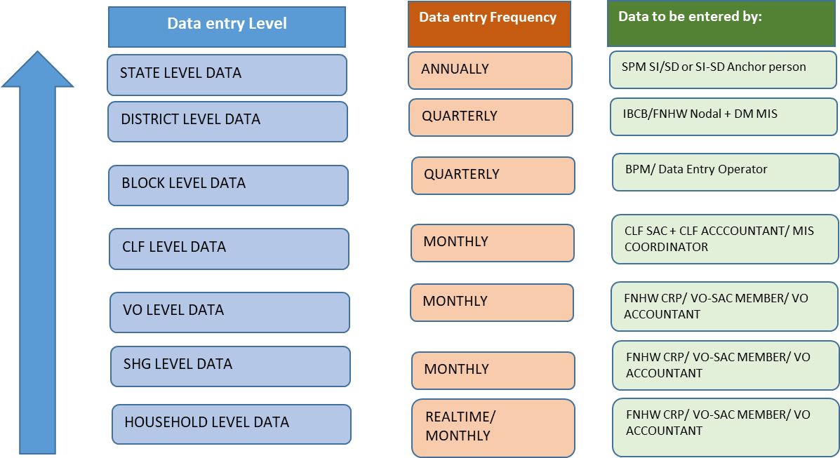
MIS and Reporting of FNHW
Reporting Mechanism

Slide 33
MIS and Reporting of FNHW
Suggested Indicators
# | Indicators
Progress of FNHW Interventions | Progress of FNHW Interventions
1 | # of target beneficiaries in SHG HHs in the reporting month (pregnant women/lactating women/adolescents/elderly etc.) | No. of CLFs initiated FNHW activities
2 | % SHGs conducted monthly meeting on FNHW | No. of SHGs conducted monthly meeting on FNHW
3 | % SHGs oriented on FNHW modules | No. of SHGs oriented on FNHW modules
4 | % SHG women oriented on FNHW modules | No. of SHG member households having functional toilet
5 | % VOs organized community events on FNHW (campaigns/rallys/competitions etc.) | No. of VOs having trained cadre on FNHW
6 | % VOs participated in VHSNC/JAS/RKS meeting | No. of VO-SAC participated in VHSND
7 | # of VO running an FNHW enterprise | No. of VOs conducted community events on FNHW
Include any other indicator as synthesized in State FNHW Operational Strategy
Ensure quality of data reported in MIS

Slide 34
Review FNHW activities
FNHW agenda should be included in the regularly scheduled review meetings
A separate dedicated FNHW meeting should be held at state/district/block/CLF/VO level.
Schedule for review
Level | Undertaken by | Participants | Frequency
State | CEO/SMD/FNHW Core Committee | SPMs of other SRLM verticals | Monthly
 | CEO/SMD/SPM (FNHW Incharge) | District Program Managers (DPMs)/District Managers (DMs) (FNHW Incharges) | Monthly
District | DPM/DM (FNHW In-charge) | Block Program Manager (FNHW In-charge) | Monthly
Block | Block Program Manager (FNHW Incharge) | CLF Leader/ SAC Members/OB/EC | Monthly
CLF | CLF Leader/SAC Members/OB/EC | VO Leader/SAC Members/CRP | Monthly
VO | VO Leader/SAC Members/CRP | FNHW nodal person at SHG level | Monthly
Objectives
To assess progress of activities against timelines
To acknowledge and share positive accomplishments
To identify and confront the flaws in performance or processes
To identify challenges and suggest course corrections
Note: States may modify the schedule and protocol based on their State implementation structure.

Slide 35
Steps to be followed
Activities should be reviewed for their progress, adherence to timelines, adherence to pre-decided protocols/processes, any challenge faced, potential solutions and course corrections
Conduct on a monthly basis
Review progress against the activities listed in FNHW Action Plan prepared by the CLF and VO.
Use CLF/VO level FNHW Activity Review formats
Discuss actions points to be taken
Action Taken Report of the previous meeting should be taken into account.
Remember: Review is NOT a fault finding exercise
Refer formats as given on slide no. 33 & 34.

Slide 38
Budget
District/Block managers should
know the budgetary provision for FNHW implementation under different heads
keep track of budget utilized and maintain records in synch with the recommended frequency (monthly/quarterly) viz-a-viz allocated budget
  Managing procurements and distribution- formation of purchase committee, identifying vendors, raising RFPs etc.
  Process utilization certificate
  Develop Statement of Expenditure
facilitate audit
share budgetary provisions for FNHW implementation under different heads with CLF and VO
Note: Add/modify based on state specific context

Slide 39
Introduction to National FNHW Resource Package

Slide 40
Identified themes under National FNHW Package
1. Linkages with livelihoods and FNHW
2. Malnutrition cycle and first 1000 days
3. Antenatal care
4. Maternal nutrition
5. Care of the newborn
6. Infant and Young Child Feeding (IYCF)
7. Balanced and diverse diet for the family
8. Nutri-gardens
9. Public Distribution System/Take Home Ration
10. Anaemia
11. Hygiene related behaviours
12. Family planning
13. Adolescent nutrition and health
14. Menstrual hygiene and related behaviours
15. Management of waste at home
16. Nutrition and health for the elderly
17. Non Communicable Diseases (NCDs) `18. Women’s health issues

Slide 41
Implementing FNHW intervention in the community
Material developed
Standard Operating Procedure Booklet- to provide detailed guidance on operational and programmatic components
Facilitator Guide for CRPs- to facilitate trainers in rolling out sessions on FNHW
Flipbooks for SHG members- to be used during SHG monthly meetings
IEC Materials for home visits, community events, etc
  Posters – for display during community events and awareness generation
  Banners – for events like campaigns and rallies
  Stickers – to serve as reminders on key messages
  Counselling Cards – to be used during home visits and smaller interactions
Presentations for orientation of state/district/block managers and CLF/VO level SAC members
Use of package is subjected to prioritizing themes, contextualizing, translation, phase wise use and implementing as per State FNHW Operational Strategy.

Slide 42



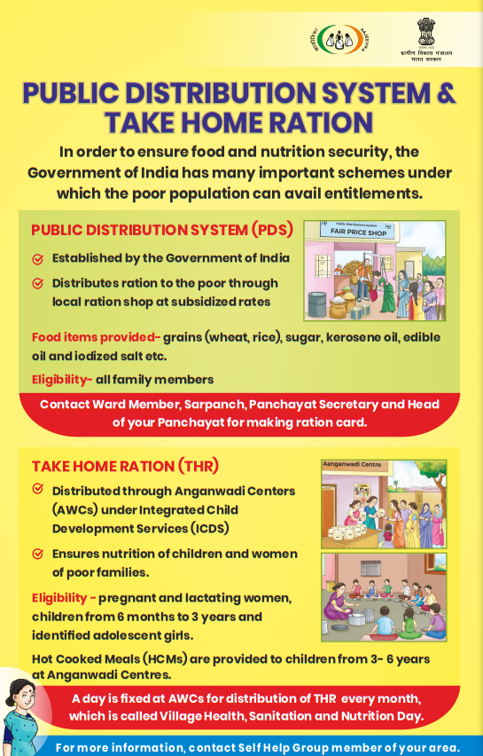
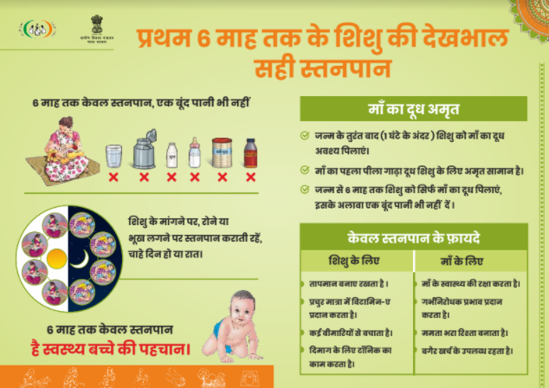

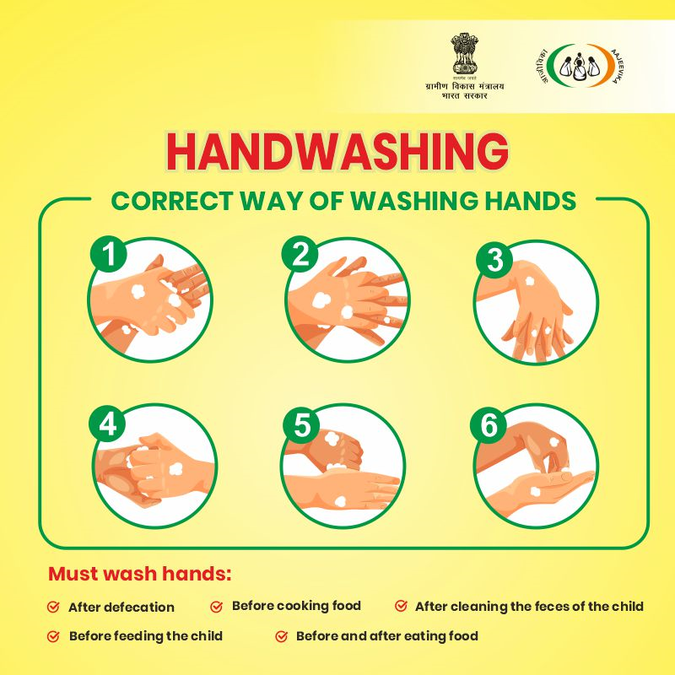
Sample of materials developed to support FNHW integration

Slide 43
Thankyou

